Slide 1
Version Control Protocols: GIT vs. SVN

Slide 2
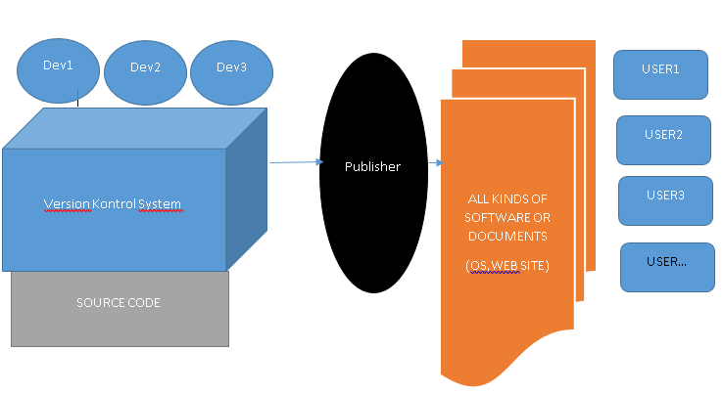
Version Control Protocols
What Is Version Control and Why Is it Important? Version control is important to keep track of changes — and keep every team member working on the right version. You should use version control software for all code, files, and assets that multiple team members will collaborate on.

Slide 3
Definitions
Repository, a data structure which stores metadata for a set of files or directory structure
Software repository, a storage location for software packages
Contrubutor
Get,Clone,Pull
Checkout,Undo Checkout
Check-in, Commit,Stage, Push

Slide 4
Version Control Protocols
In software engineering, version control
also known as
revision control
source control
source code management
is a class of systems responsible for managing changes to computer programs, documents, large web sites, or other collections of information
Version control is a component of software configuration management.
In software engineering, software configuration management (SCM or S/W CM) is the task of tracking and controlling changes in the software, part of the larger cross-disciplinary field of configuration management.SCM practices include revision control and the establishment of baselines. If something goes wrong, SCM can determine the "what, when, why and who" of the change. If a configuration is working well, SCM can determine how to replicate it across many hosts.

Slide 5
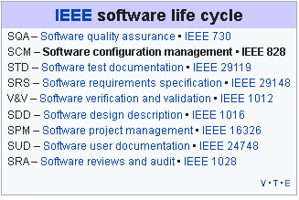
Position of Protocol
IEEE Software life cycle→SCM→Version Control
SCM
Configuration identification - Identifying configurations, configuration items and baselines.
Configuration control - Implementing a controlled change process. This is usually achieved by setting up a change control board whose primary function is to approve or reject all change requests that are sent against any baseline.
Configuration status accounting - Recording and reporting all the necessary information on the status of the development process.
Configuration auditing - Ensuring that configurations contain all their intended parts and are sound with respect to their specifying documents, including requirements, architectural specifications and user manuals.
Build management - Managing the process and tools used for builds.
Process management - Ensuring adherence to the organization's development process.
Environment management - Managing the software and hardware that host the system.
Teamwork - Facilitate team interactions related to the process.
Defect tracking - Making sure every defect has traceability back to the source.
With the introduction of cloud computing and DevOps the purposes of SCM tools have become
merged in some cases.

Slide 6
Version Control
In computer software engineering, revision control is any kind of practice that tracks and provides control over changes to source code, document, configuretion files…
As teams design, develop and deploy software, it is common for multiple versions of the same software
At the simplest level, developers could simply retain multiple copies of the different versions of the program, and label them appropriately

Slide 7
Version Control Software Model
Local data model
In the local-only approach, all developers must use the same file system.(Revision Control System (RCS), Source Code Control System (SCCS) – part of UNIX)
Client-server model
In the client-server model, developers use a shared single repository.
IBM Rational ClearCase, Visual SourceSafe –by Microsoft; oriented toward small teams
Team Foundation Version Control - by Microsoft for Team Foundation Server, now Azure DevOps Server
Concurrent Versions System (CVS) – originally built on RCS, licensed under the GPL.
Subversion (SVN) – versioning control system inspired by CVS
TortoiseSVN Windows client for the Apache™ Subversion® version control system

Slide 8
Version Control Software Model
Distributed model
In the distributed approach, each developer works directly with their own local repository, and changes are shared between repositories as a separate step.
BitKeeper – was used in Linux kernel development (2002 – April 2005)
Git – written in a collection of Perl, C, and various shell scripts, designed by Linus Torvalds based on the needs of the Linux kernel project; decentralized, and aims to be fast, flexible, and robust
Comparison of version-control software
Comparison of source-code-hosting facilities

Slide 9
Git History
Git development began in April 2005 ( Linux Developer gave up BitKeeper)
Linus Torvalds wanted a distributed system that he could use like BitKeeper
Take Concurrent Versions System (CVS) as an example of what not to do; if in doubt, make the exact opposite decision.
Support a distributed, BitKeeper-like workflow.
Include very strong safeguards against corruption, either accidental or malicious.

Slide 10
What is Distributed?
In software development, distributed version control (also known as distributed revision control) is a form of version control in which the complete codebase, including its full history, is mirrored on every developer's computer. Compared to centralized version control, this enables automatic management branching and merging, speeds up most operations (except pushing and pulling), improves the ability to work offline, and does not rely on a single location for backups. Git, the world's most popular version control system, is a distributed version control system.

Slide 11
Distributed vs. centralized
Distributed version control systems (DVCS) use a peer-to-peer approach to version control, as opposed to the client–server approach of centralized systems. Distributed revision control synchronizes repositories by transferring patches from peer to peer. There is no single central version of the codebase; instead, each user has a working copy and the full change history
Advantages of DVCS
Allows users to work productively when not connected to a network.
Common operations (commits, viewing history, reverting changes..)
Communication is necessary only when sharing changes among other peers
Allows private work
Avoids relying on one physical machine as a single point of failure

Slide 12
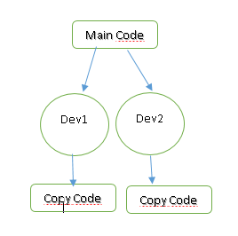
Distributed vs. centralized
DisAdvantages of DVCS
Initial checkout of a repository is slower as compared to checkout in a centralized version control system, because all branches and revision history are copied to the local machine by default.
Additional storage required for every user to have a complete copy of the complete codebase history.

Slide 13
Operations of Contrubutor
CLONE OR COPY | FORK
PULL | PULL
MERGE | MERGE
COMMIT | COMMIT
PUSH | PULL REQUEST –MERGE REQUEST

Slide 14
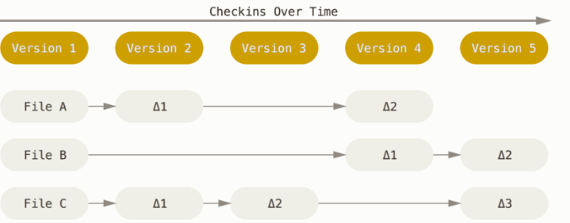
What is Git?
Git is a free and open source distributed version control system designed to handle everything from small to very large projects with speed and efficiency.
The major difference between Git and any other VCS
delta-based version control

Slide 15
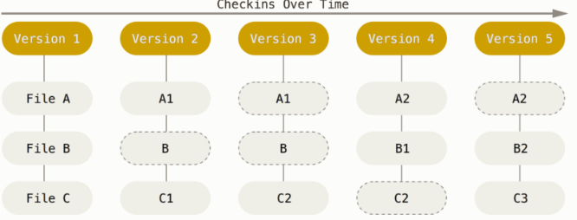
Git thinks about its data more like a stream of snapshots.
This makes Git more like a mini filesystem with some incredibly powerful tools built on top of it, rather than simply a VCS.

Slide 16
What is Git?
Nearly Every Operation Is Local
For example, to browse the history of the project, Git doesn’t need to go out to the server to get the history and display it for you
Git Has Integrity (SHA-1 hash)
Everything in Git is checksummed before it is stored and is then referred to by that checksum. This means it’s impossible to change the contents of any file or directory without Git knowing about it.
Git Generally Only Adds Data
You can lose or mess up changes you haven’t committed yet, but after you commit a snapshot into Git, it is very difficult to lose, especially if you regularly push your database to another repository.

Slide 17
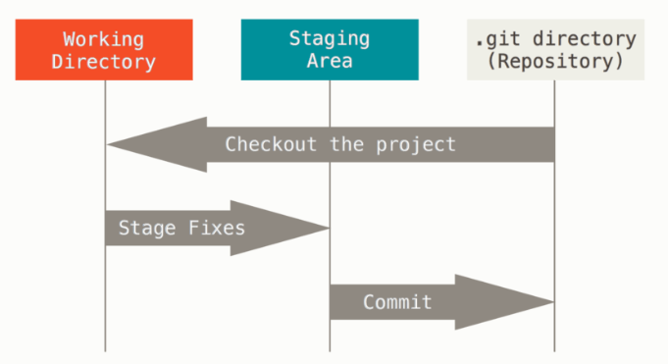
Git -The Three States
modified, staged, and committed:
Modified means that you have changed the file but have not committed it to your database yet.
Staged means that you have marked a modified file in its current version to go into your next commit snapshot.
Committed means that the data is safely stored in your local database.

Slide 18
Git Protocols to transfer data (TCP)
Git uses Local, HTTP, Secure Shell (SSH) and Git
LOCAL→remote repository is in another directory on the same host
The most basic is the Local protocol, in which the remote repository is in another directory on the same host. This is often used if everyone on your team has access to a shared filesystem such as an NFS mount, or in the less likely case that everyone logs in to the same computer. The latter wouldn’t be ideal, because all your code repository instances would reside on the same computer, making a catastrophic loss much more likely.
$ git clone /srv/git/project.git
+of file-based repositories are that they’re simple and they use existing file permissions and network access. If you already have a shared filesystem to which your whole team has access, setting up a repository is very easy.
HTTP→ Dumb HTTP Smart HTTP ,

Slide 19
Git Protocols to transfer data (TCP)
1.Dumb HTTP
If the server does not respond with a Git HTTP smart service, the Git client will try to fall back to the simpler Dumb HTTP protocol. The Dumb protocol expects the bare Git repository to be served like normal files from the web server
2.Smart HTTP
Smart HTTP operates very similarly to the SSH or Git protocols but runs over standard HTTPS ports and can use various HTTP authentication mechanisms
SSH
A common transport protocol for Git when self-hosting is over SSH. This is because SSH access to servers is already set up in most places — and if it isn’t, it’s easy to do. SSH is also an authenticated network protocol and, because it’s ubiquitous, it’s generally easy to set up and use.
$ git clone ssh://[user@]server/project.git

Slide 20
Git Protocols to transfer data (TCP)
-Finally, we have the Git protocol. This is a special daemon that comes packaged with Git; it listens on a dedicated port (9418) that provides a service similar to the SSH protocol, but with absolutely no authentication. You can enable push access but, given the lack of authentication, anyone on the internet who finds your project’s URL could push to that project.
-The Git protocol is often the fastest network transfer protocol available. It uses the same data-transfer mechanism as the SSH protocol but without the encryption and authentication overhead.
-The downside of the Git protocol is the lack of authentication. It’s generally undesirable for the Git protocol to be the only access to your project. Generally, you’ll pair it with SSH or HTTPS access for the few developers who have push (write) access and have everyone else use git:// for read-only access. It’s also probably the most difficult protocol to set up. It also requires firewall access to port 9418, which isn’t a standard port that corporate firewalls always allow. Behind big corporate firewalls, this obscure port is commonly blocked.

Slide 21
What is SVN
SVN stands for Subversion. It is called as SVN because of its commands (its command name svn). It is a centralized version control system. It is an open-source tool for version control.
SVN is used to manage the current and previous versions of files like source code, documentation, and files. It acts as the time machine for the developers and allows them to go back and browse the history of the project.
Some other popular version control systems like Git are in trend now, but there are a large number of projects that are still running on the Subversion.
Subversion is open-source and comes under the Apache License, and it was developed by CollabNet Inc in 2000. It was operated much like CVS (Concurrent versions system). In 2009, Apache Incubator accepted it and made it a top-level apache product.

Slide 22
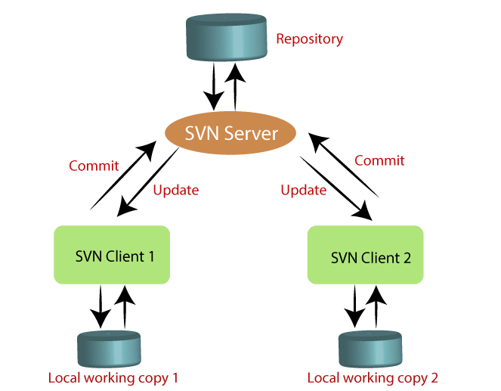
SVN
The features of SVN are as follows:
It supports atomic commits (Either it will occur or not).
It keeps a full revision history.
It supports Internationalized program message.
It provides file locking for the files that cannot be merged.
The usage of SVN server is as follows:
It provides security to customer.
It offers remote access.
It provides the read and write access to multiple destinations through the SVN client-server.
It can store the complete version of the requirements.
The usage of SVN client is as follows:
It communicates with the SVN server.
It provides remote and manual access.
It provides the interface.
It is free and open-source.

Slide 23
Svn Protocols to transfer data (TCP)
http://repos
http:// has a serious overhead, especially when dealing with thousands of small files.
https://repos
preferably https because of the encryption-and-authentication layer
svn://repos
svn:// or svn+ssh:// are faster than HTTP(S)
svn+ssh://repos
svn+ssh is the svn protocol run inside a SSH tunnel. The client uses SSH to log on the remote server and remotely runs the svn command in that tunnel.

Slide 24
SVN | Git
It's a Centralized version control system | It's a distributed version control system.
It is revision control. | Git is an SCM (source code management).
It does not keep a cloned repository. | It has a cloned repository.
Branches in SVN are a folder that takes place in the repository. Some special commands are required For merging the branches. | The Git branches are familiar to work. The Git system helps in merging the files quickly and also assists in finding the unmerged ones.
It has an internationalized revision number. | It does not have a Global revision number.
SVN does not contain any cryptographically hashed contents. | It has cryptographically hashed contents that protect the contents from repository corruption taking place due to network issues or disk failures.
SVN stores content as files. | Git stored content as metadata.
SVN's content is less secure than Git. | Git has more content protection than SVN
SVN's content is less secure than Git. | Git has more content protection than SVN.
CollabNet, Inc developed SVN. | Linus Torvalds developed git for Linux kernel.
SVN is distributed under the open-source license. | Git is distributed under GNU (General public license)

Slide 25
Teşekkürler

